Slide 1
BigData Project
Contents:
File Structure on HDFS
Data Collected
Basic queries
Some visualization
YAO ZELIANG BI 1 20130502
ZHANG MENG BI 2 20160500

Slide 2
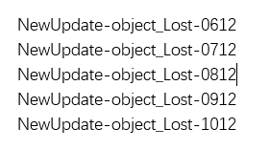
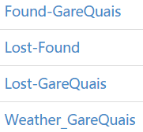
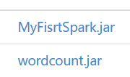
Archive Data
New Data Collected
Object_Lost
New_Update
Origin-Data
New Generated
Object_Found
BackUp
Old Refresher
Weather
user
GareQuais
New_Update
BackUp
Joined_Tables
New_Update
HDFS
BackUp
Log
Temporary File
Workspace (where we put jar files for futher use...)

Slide 3
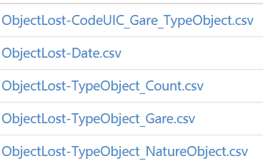
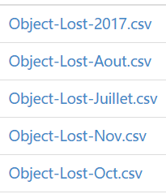


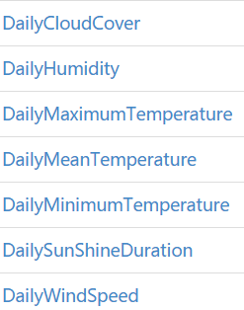
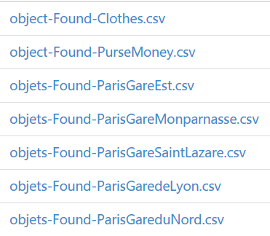

Data Collected:
Lost_Object Data:
Found_Object Data:
Weather Data:
Gare,Quais Data:

Slide 4
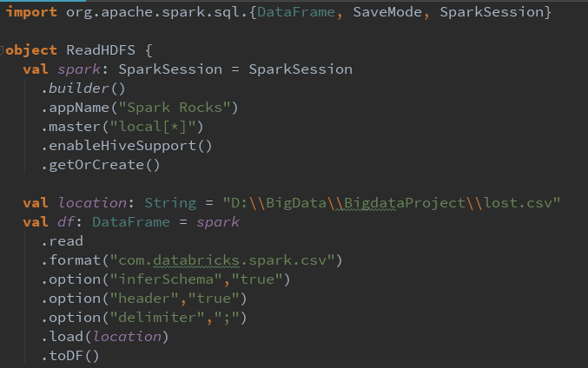
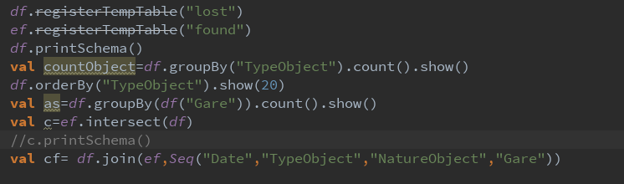
Basic queris
We use Spark DataFrame as container to do the queries, generate new tables,filter the data and other operation

